Slide 1
Broadband in Coal Mines
Ben Aiken
MUSA Capstone 2022

Slide 2
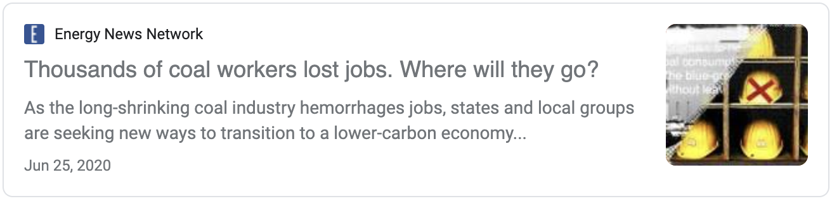
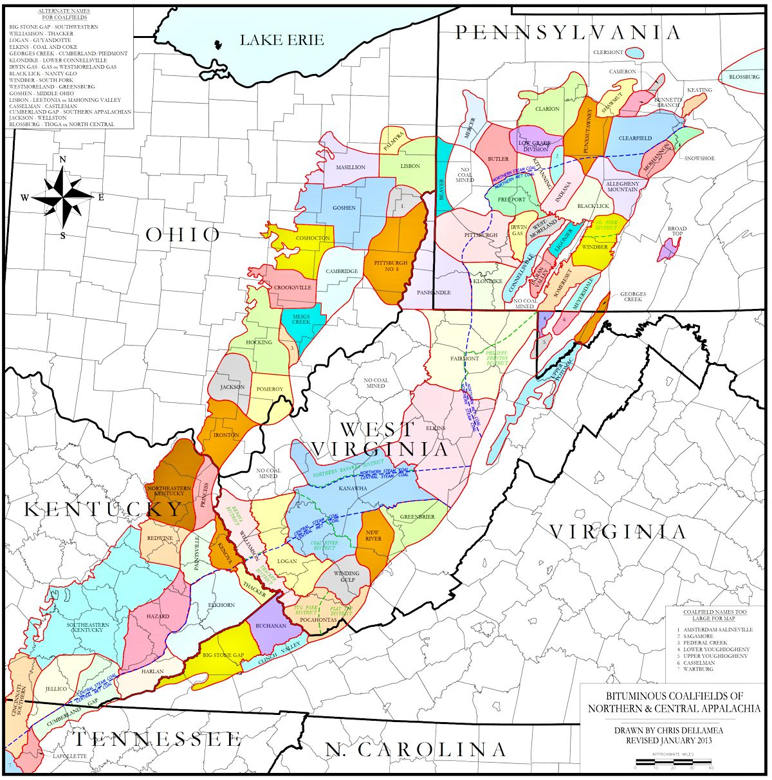
The Problem
Since 2012, 300 coal-fired power plants have closed
A win for the environment
But a loss for workers: 44,000 coal mining jobs eliminated

Slide 3

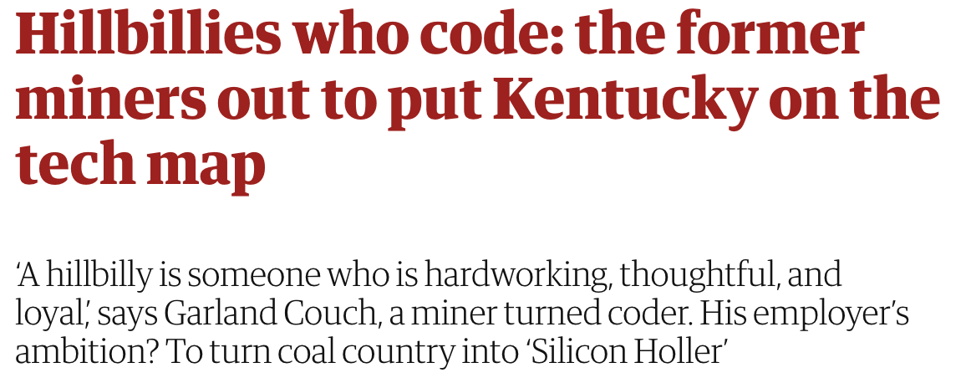
A Possible Solution
Develop a “Silicon Holler”
in Appalachia
The question:
How should the broadband resources of the Infrastructure Investment and Jobs Act be distributed in Appalachia to spur the greatest economic impact?

Slide 4
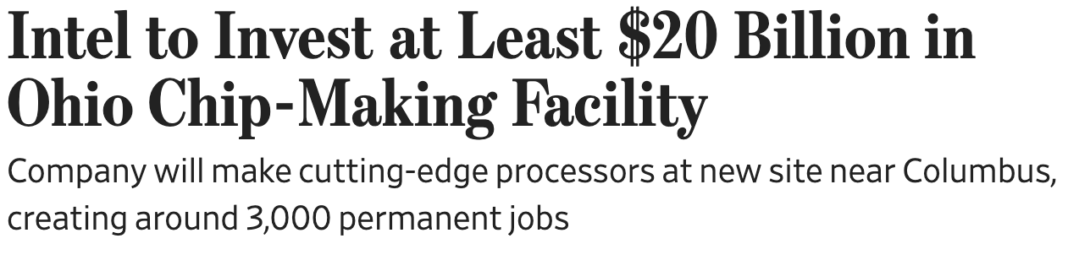

Is this a viable solution?
Past hurdles:
Tech companies have been resistant to move to Appalachia
IBM has set up factories in the rust belt
Limited success in Tech Valley in the Hudson Valley region of New York state suggests opportunity
Remote work wasn’t possible, but since COVID virtual work has become the norm
Limited computer science education
Several non-profits have targeted the region with variable successes
Beauty of computer science and coding – much of it can be done remotely
Lack of high-speed internet
Focus of this study!

Slide 5
My Approach
Produce a report that introduces the “Silicon Holler” concept and explains why this is reasonable now, detailing past efforts.
Then present the relevant data including:
Demographics
Economic trends
Education trends
Cost of implementation
Existing resources
Develop an interactive dashboard that allows users to adjust their priorities and generate a county/census tract order
Suggest my prioritization method

Slide 6
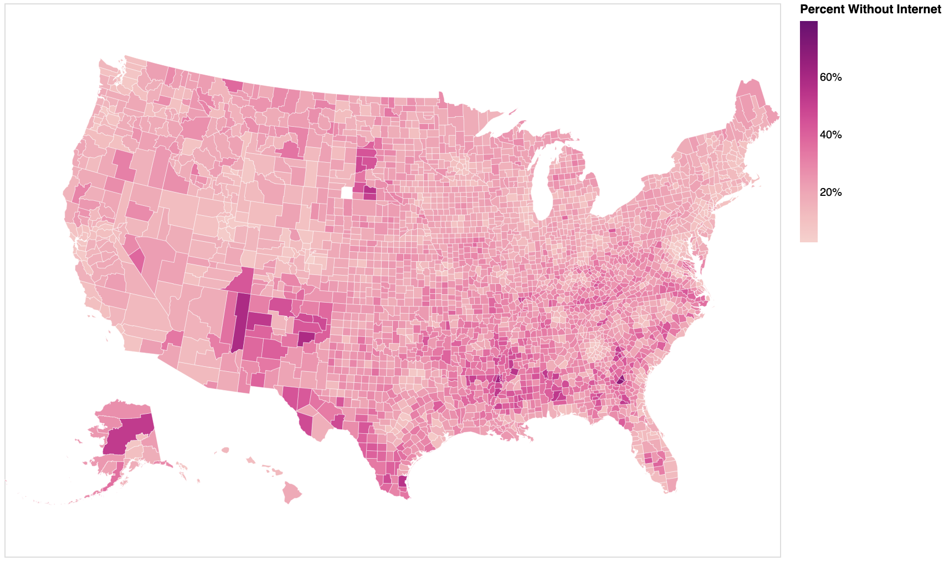
Broadband in Appalachia

Slide 7
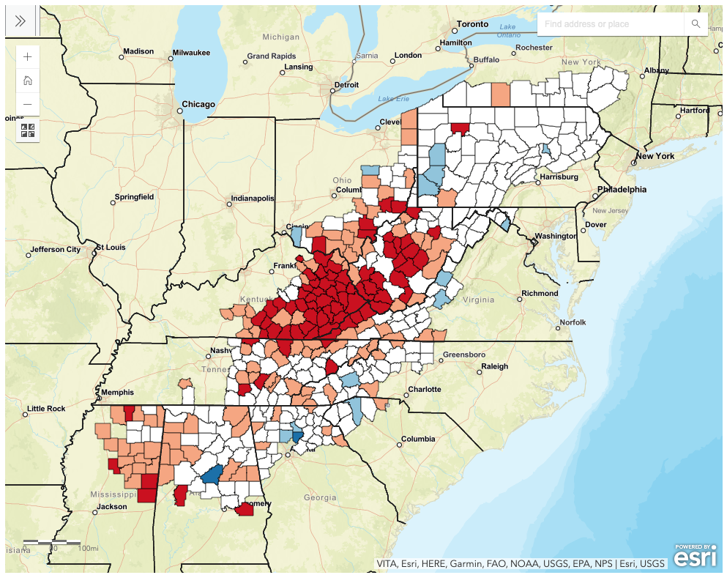
Economic Trends
The Appalachian Regional Commission releases comprehensive reports about the economic status and trends of the region.
78 distressed counties
104 at-risk
These classifications are based on:
Unemployment
Income
Poverty rates

Slide 8
Dashboard Wireframe
What would you prioritize in broadband implementation?
Adjust the order of the factors below to re-color the map and reveal which counties/census tracts that would be prioritized. Use the map filters and address search bar to learn more.
1) Implementation Cost
2) Education Trends
Educational Attainment
Access to higher education
3) Demographics
Age of Population
Population Density
4) Economic Trends
Joblessness
Mine Locations
Income
Existing Industry
5) Existing Resources
Access to internet, regardless of speed

Slide 9
Next Steps/Questions
I need to:
Complete regional study. Specifically, a deeper investigation into the cost of implementation and economic trends of the region.
Refine existing visuals and produce more maps of each study area
Build out the dashboard
What prioritization factors am I missing?
What features of the dashboard would make it user friendly?
For example, I could add a scaling factor in addition to the ordering feature.

